Slide 1

INTRODUCTION TO POWER BI

Slide 2
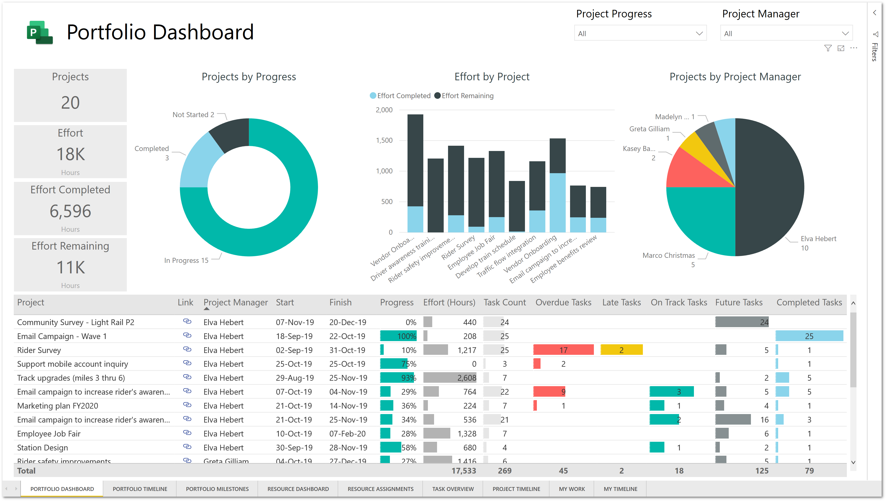
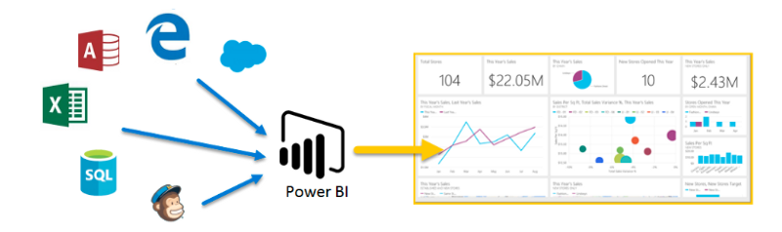
What is Power BI
Power BI is a data analytics tool provided by Microsoft.
Power BI gives the ability to analyze and explore data on-premise as well as in the cloud.
It provides interactive visualizations with intelligence capabilities, where users can use to create reports and dashboards by themselves, without having to depend on information technology staff or database administrators.
Power BI provides the ability to collaborate and share customized dashboards and interactive reports across colleagues and organizations, easily and securely.
Power BI is a ad hoc reporting tool which allows every user to become involved in the report creation and analysis process.
Usage of Data Analysis in Industry:
A Car Manufacturer will make decision to produce the number of cars for the next year based upon sales analysis and year-on-year growth
A Bank will plan to open new branches based upon the customers accounts, deposit predictions

Slide 3
Benefits of Power BI
Integrates seamlessly with different data sources.
Rich personalized dashboards.
Provides a cloud-based as well as a desktop interface.
Publish reports securely over web and mobile apps
Export to different format like PDF and PPT
Integrated with different web applications and SharePoint applications
Easily scalable across the entire organization.

Slide 4
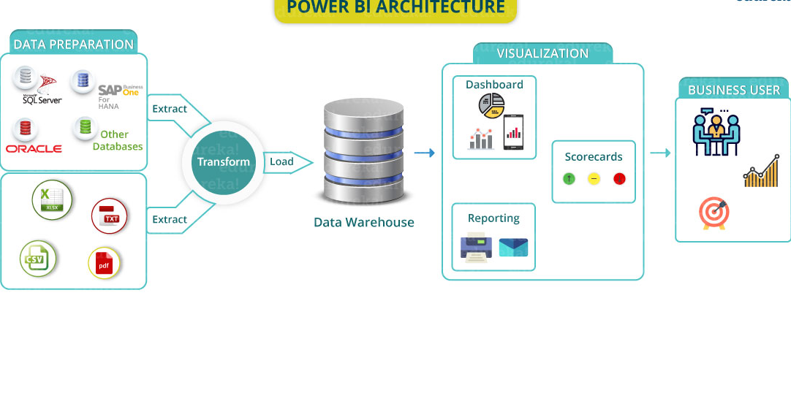
Power BI Consists of Four Components/Phases
Data Sources Components | Data Transformation | Data Visualization | Publishing & Sharing
Power BI Applications
Power BI Desktop | Power BI Web | Power BI Mobile

Slide 5
Components of Power BI
Data Sources Components | Data Transformation | Data Visualization | Publishing & Sharing
Files Sources Database Sources Analytical Sources Azure Sources Web Sources Other Sources (SalesForce, Dynamics etc) | Remove Rows Filter Data Remove Columns Split Columns Merge Columns Add Columns Merge Data Append Data Pivot Group By | Bar Charts Pie Chart Funnel TreeMap Maps Table Matrix | Power BI Web Sharing PBIX file Export to PDF Export to PPT Power BI Mobile Views

Slide 6
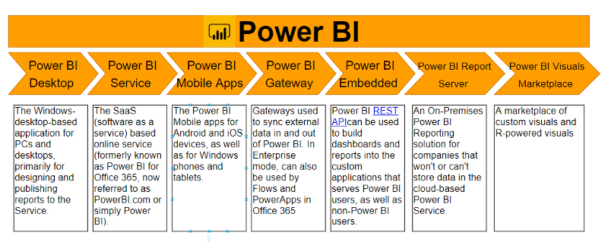
Power BI

Slide 7
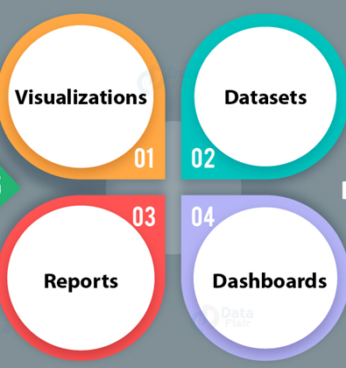
Building blocks of Power BI (Major block of Power BI Reporting)
Power BI

Slide 8
Dataset:
Data-set is nothing but a collection of data or information.
Power BI harnesses this data to create visualizations.
It can be a simple data set or a combination of many different sources, which can be filtered and combined to provide a different data set altogether.

Slide 9
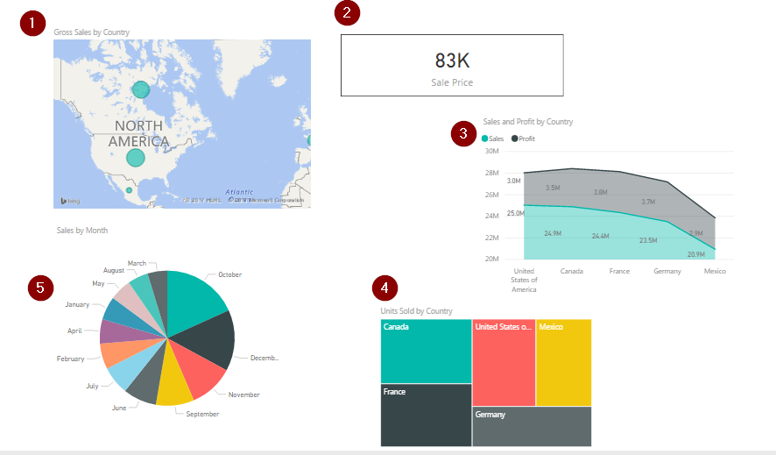
Visualizations: A visual representation of data is called visualization. For example, a chart or a graph can be used to represent data visually.
1.Map representation
2.Card visualization
3.Stacked area chart
4.Tree map
5.Pie chart

Slide 10
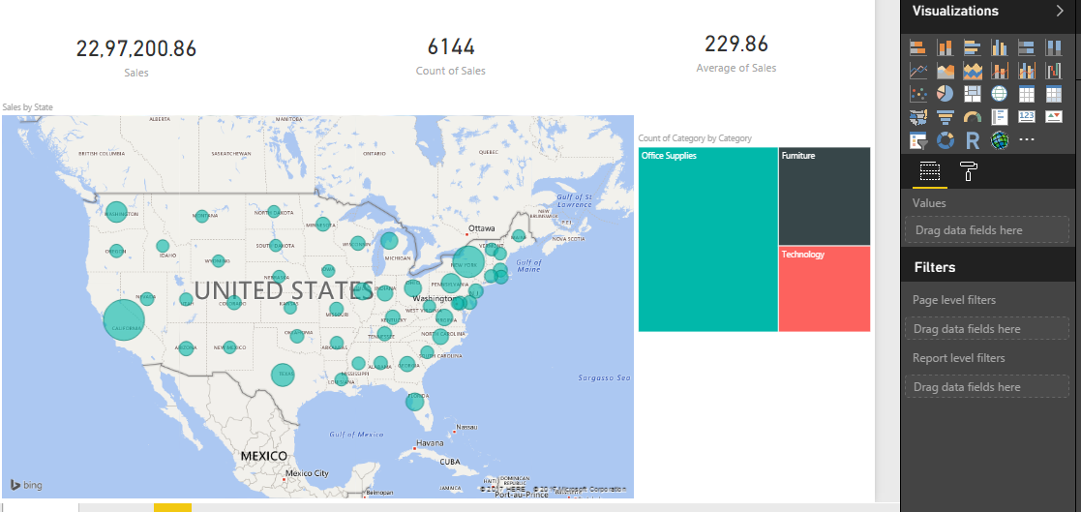
Reports: A collection of visualizations that appear together on one or more pages is a report in Power BI. It is a collection of items that are related to one another.

Slide 11
Dashboards: A Power BI dashboard is a single page interface. It is often called a canvas, that uses visualizations to tell a story.

Slide 12
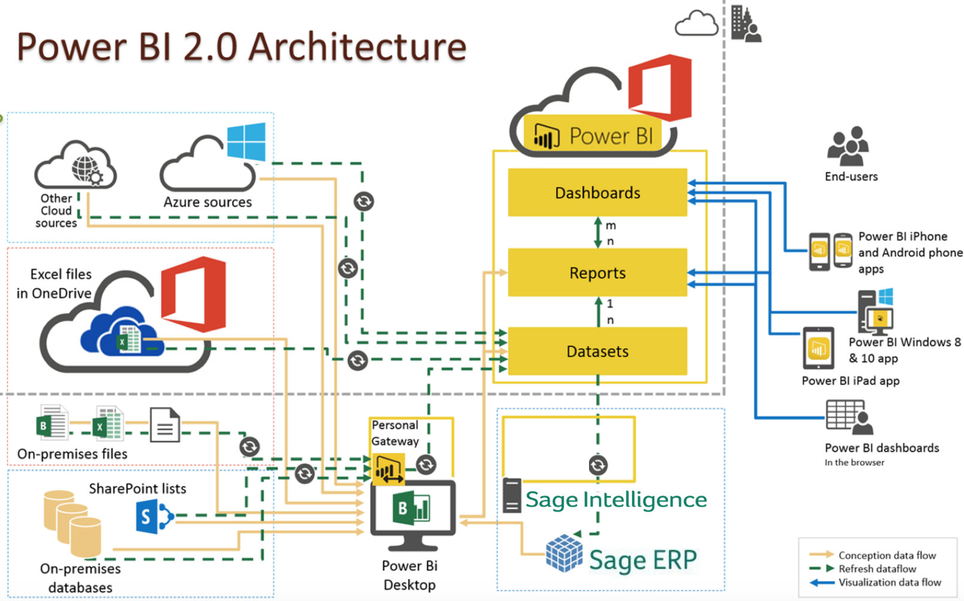
Architecture

Slide 13
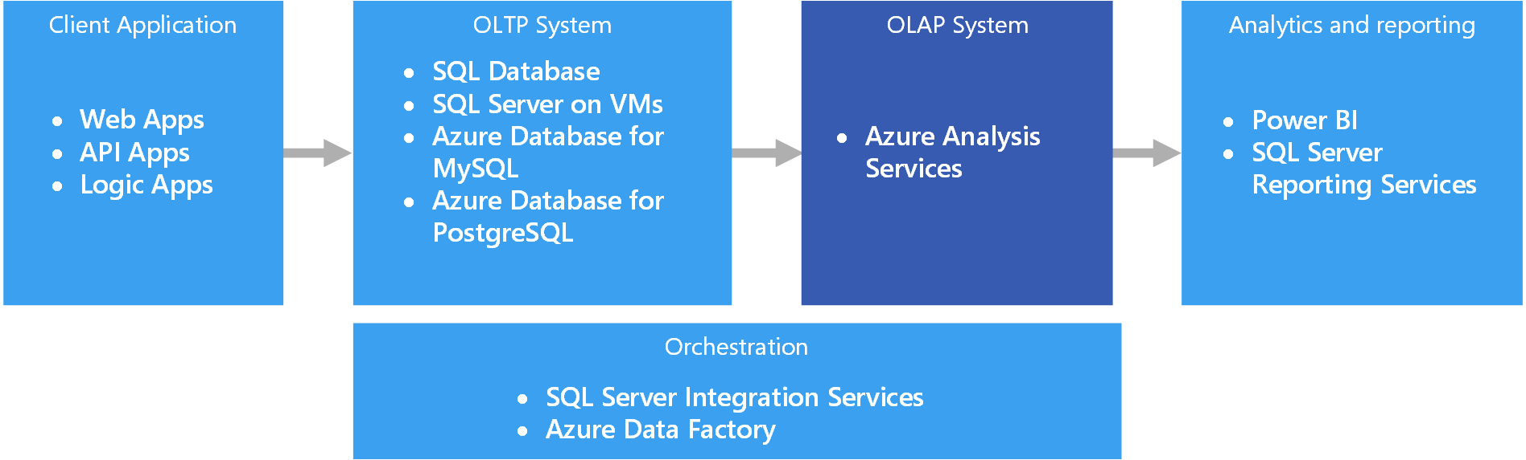
Different Types of Systems, Databases & Reporting Tools

Slide 14
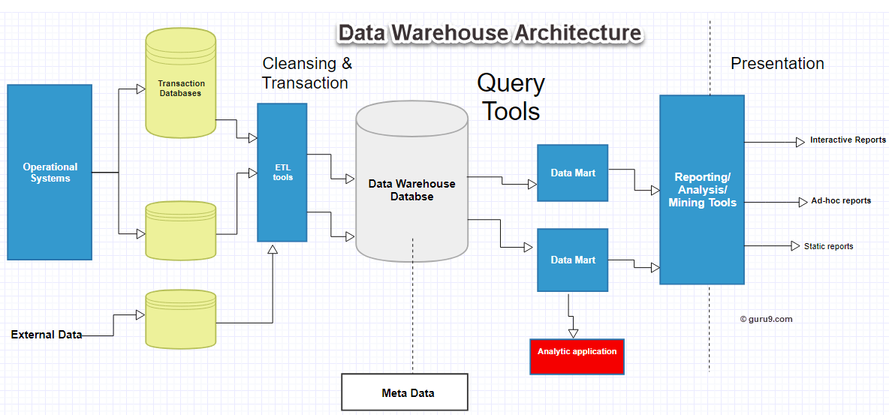
Different Types of Systems, Databases & Reporting Tools

Slide 15
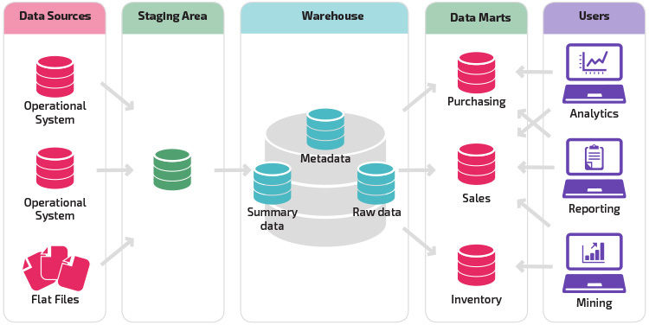
Different Types of Systems, Databases & Reporting Tools

Slide 16
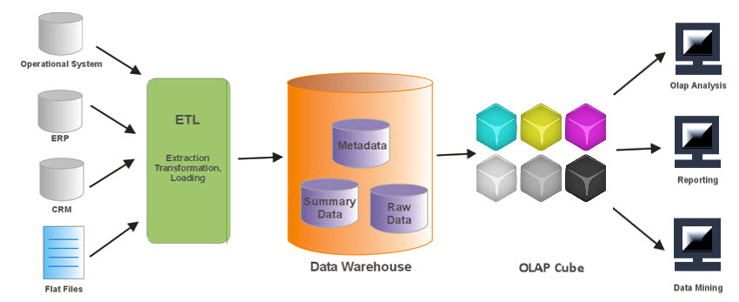
Different Types of Systems, Databases & Reporting Tools

Slide 17
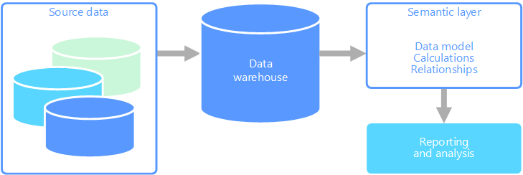
Flow of Reporting & Analysis

Slide 18
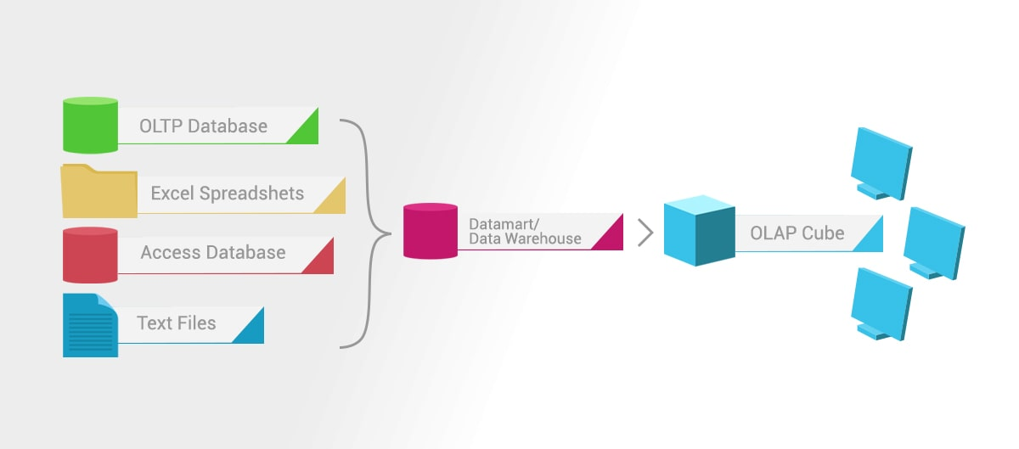
How Data is Prepared for Reporting

Slide 19
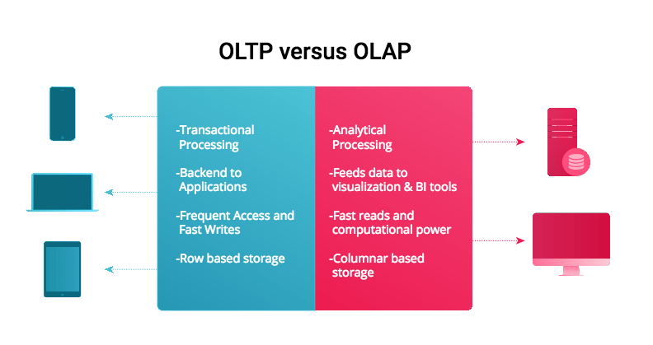
How Data is Prepared for Reporting

Slide 20
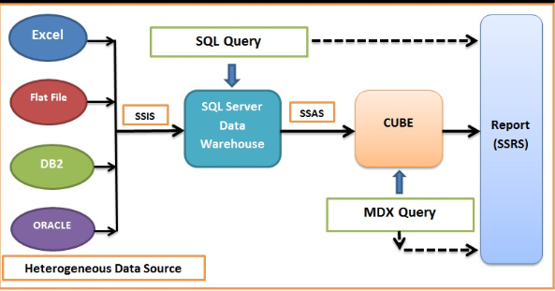
Enterprise Data Architecture (MSBI) Power BI is a subset to MSBI which is used for which is used for Data Visualizations.

Slide 21
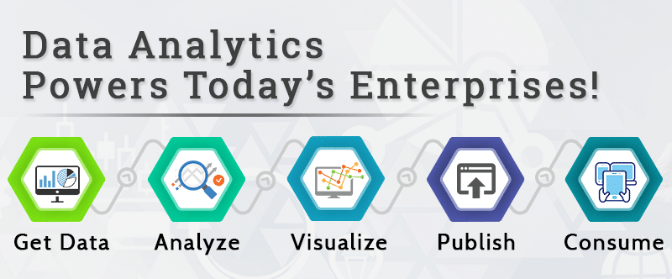
Power BI Enterprise Flow (Different phases of Power BI)

Slide 22
Different phases of Power BI Reporting.
1. Data Sources/ Data Connectors
2. Data Integration /Transformation
3. Data Processing / Cleaning
4. Data Visualizations
5. Publishing
6. Sharing To Business users
1. Data Sources / Data Connectors
Data Sources is connecting to different data sources like file sources, data sources ,web sources etc. and pulling the data into power bi datasets.
2. Data Integration / Transformation
Data integration involves combining data residing in different sources and providing users with a unified view of them.

Slide 23
3. Data Processing /Cleaned
The integrated data is still not ready for visualization because the data needs processing before it can be presented. This data is pre-processed or cleaned.
4. Data Visualization
So once the data is loaded and processed now it can be visualized much better with use of various visualizations that Power BI has to offer. Use of reports, dashboards help one represent data in more intuitive manner. These visuals, reports help business end users to take business decisions based on the insights.

Slide 24
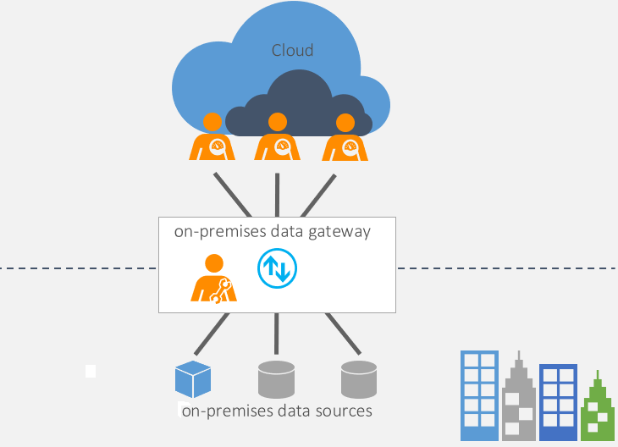
5. Publishing
The Report created by Power BI Desktop will be deployed into web interface of Power BI Cloud Services. Now the Power BI Report is on web which can be viewed by anyone over web and integrated with different applications.
6. Sharing with Business users
The Report once deployed can be shared in web url. The Report can be exported into different formats and shared. The Desktop report can also be shared with users as a Template.

Slide 25
Steps for Creating a Report in Power BI.
1. Open Power BI Desktop version
(To use Power BI, we need to download and install Power BI)
2. Create a New Report Page in Power BI
3. Connect to data sources and fetch the data from files, databases etc.
4. Go To Visualization Pane and Bind Data into Charting Components
5. Format the Visualization
6. Save the Report as a File.(PBIX)
7. Publish the Report (For Publishing the report account needs to created in Power BI)
8. Share the Report

Slide 26
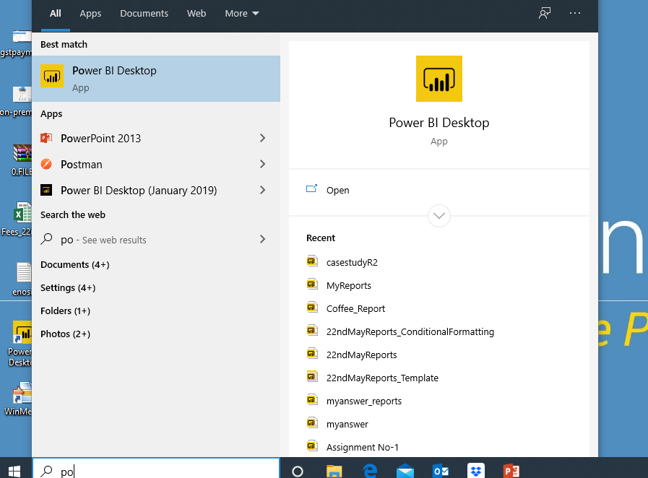
Steps 1 : Open Power BI Desktop version

Slide 27
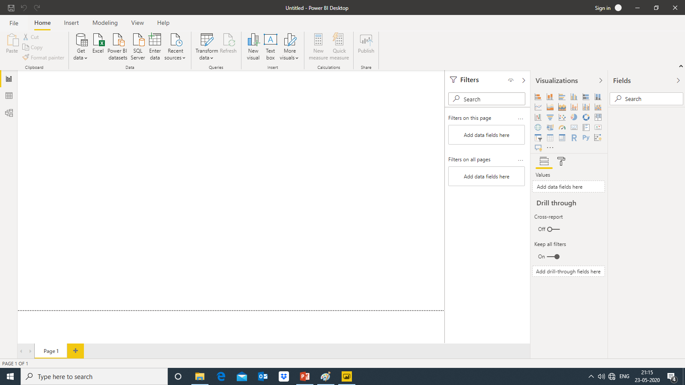

Slide 28
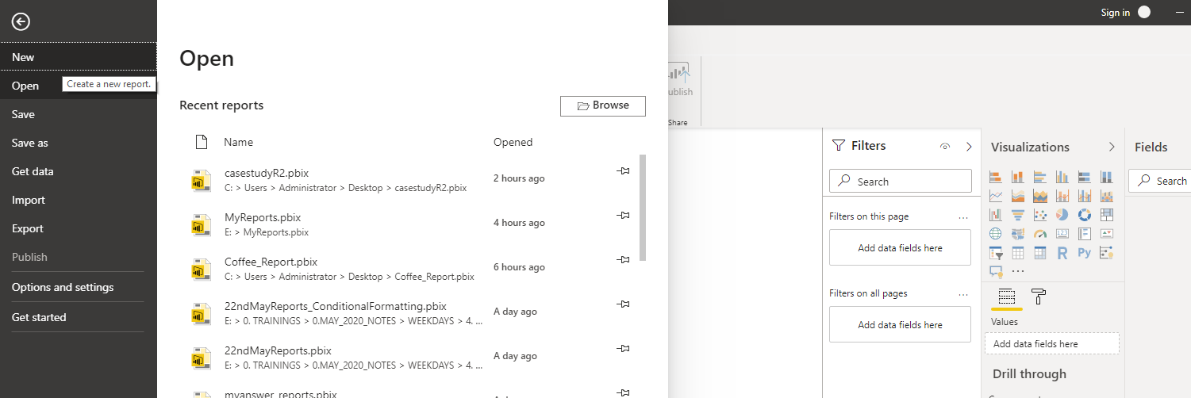
Steps 2 : Create a New Report Page in Power BI

Slide 29
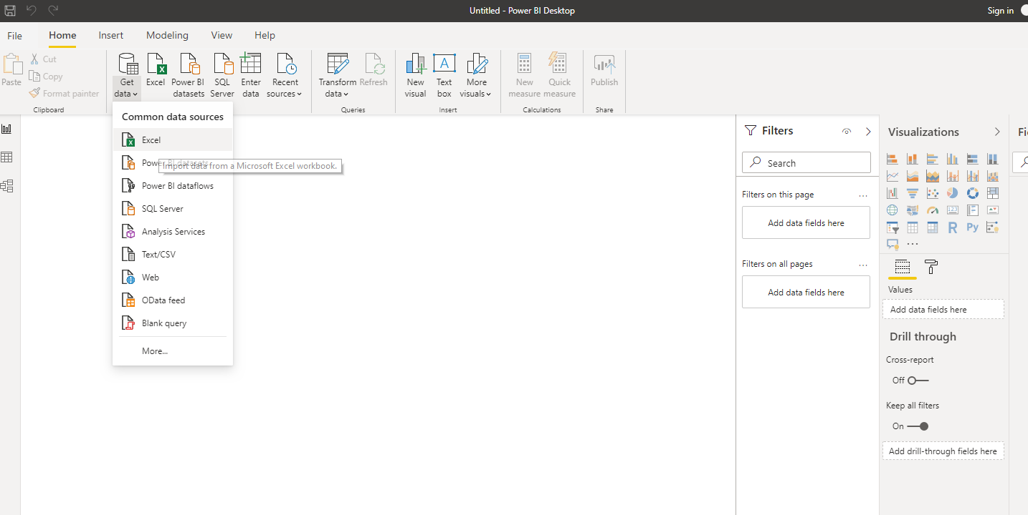
Steps 3 : Connect to data sources and fetch the data from files, databases etc.

Slide 30
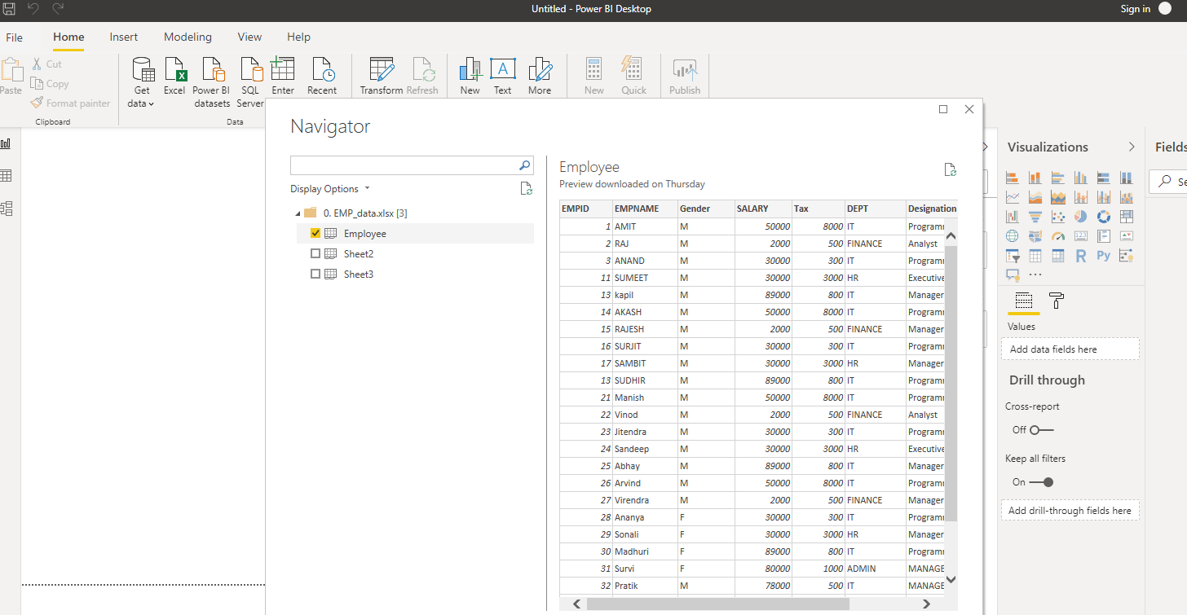
Steps 3 : Connect to data sources and fetch the data from files, databases etc.

Slide 31
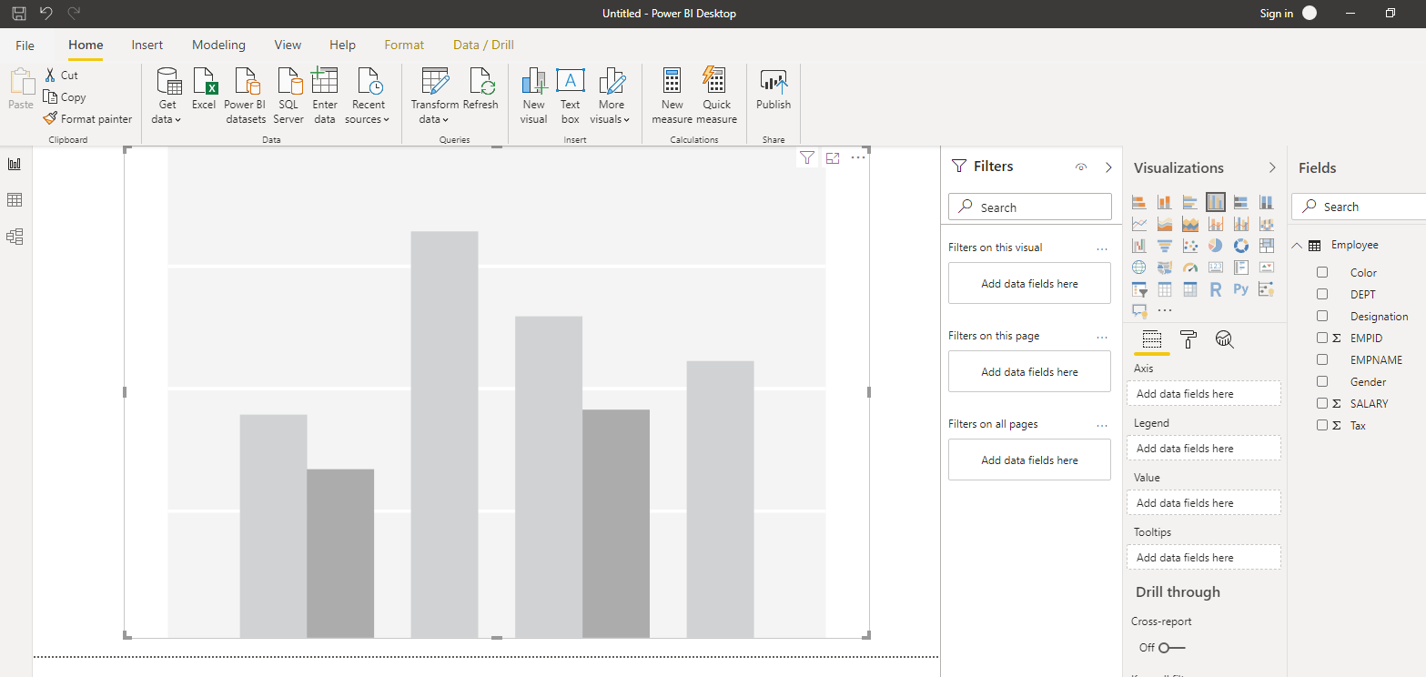
Steps 4 :Go To Visualization Pane and Bind Data into Charting Components

Slide 32
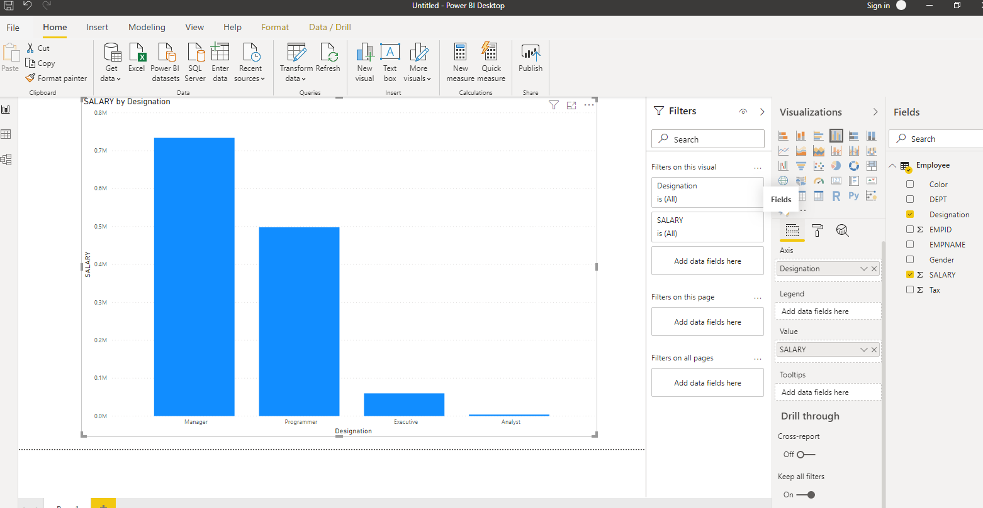
Steps 4 : Go To Visualization Pane and Bind Data into Charting Components

Slide 33
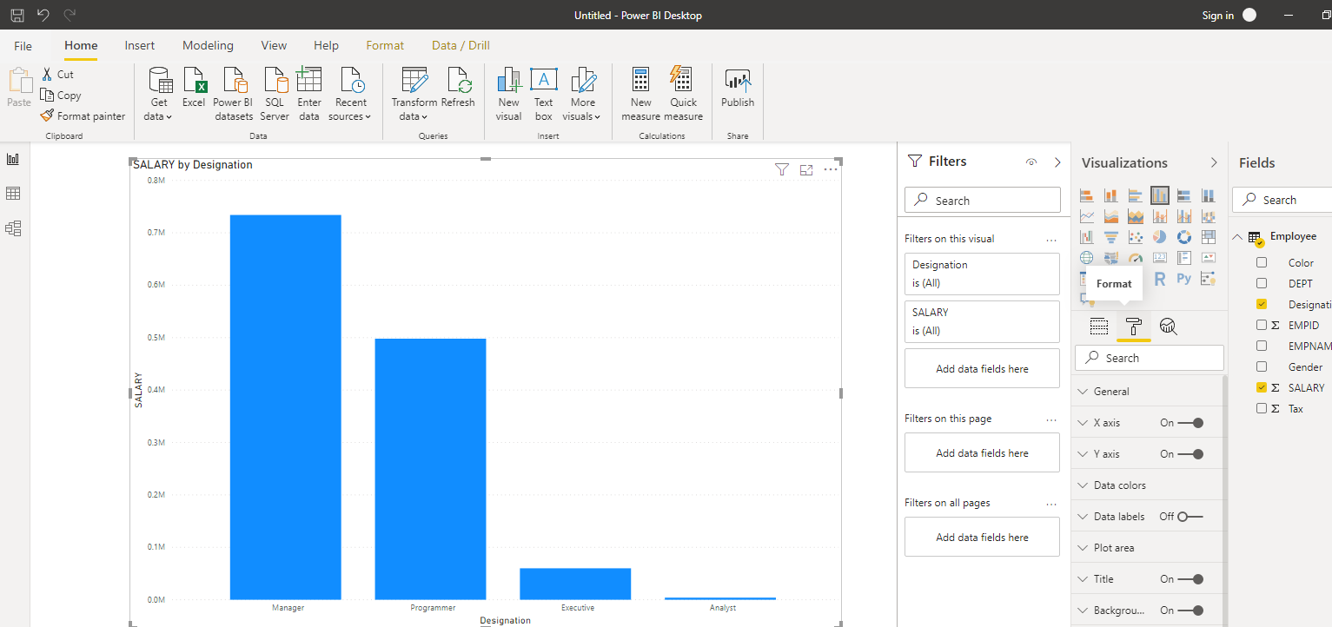
Steps 5 : Format the Visualization

Slide 34
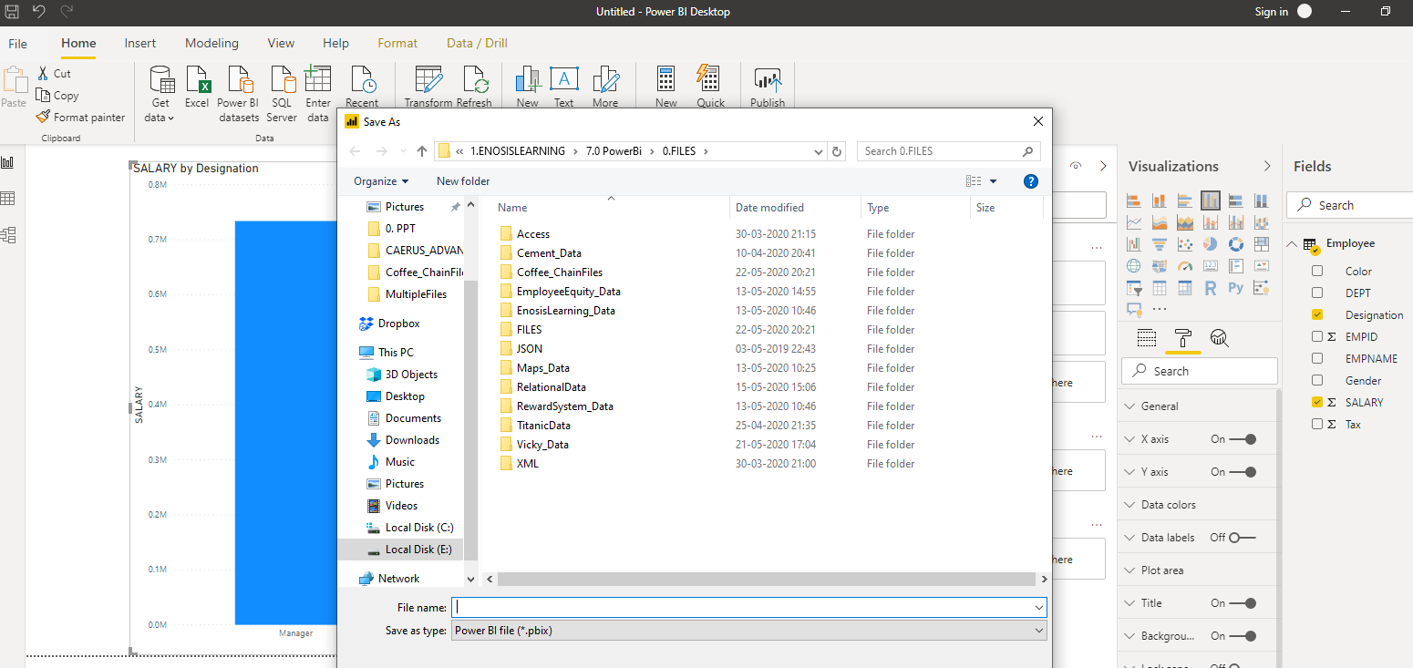
Steps 6 : Save the Report as a File

Slide 35
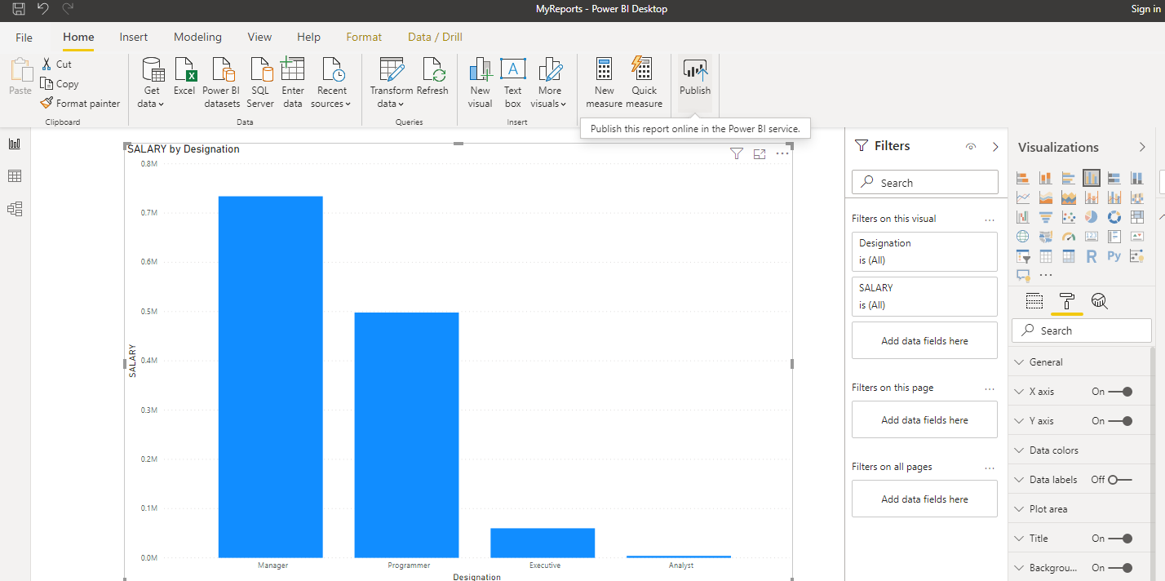
Steps 7 : Publish

Slide 36

Steps 7 : Publish

Slide 37
THANK YOU

